Slide 1
Introduction to Huawei ICT Academy
In cooperation with Stichting Praktijkleren
Thursday 6 December 2018

Slide 2
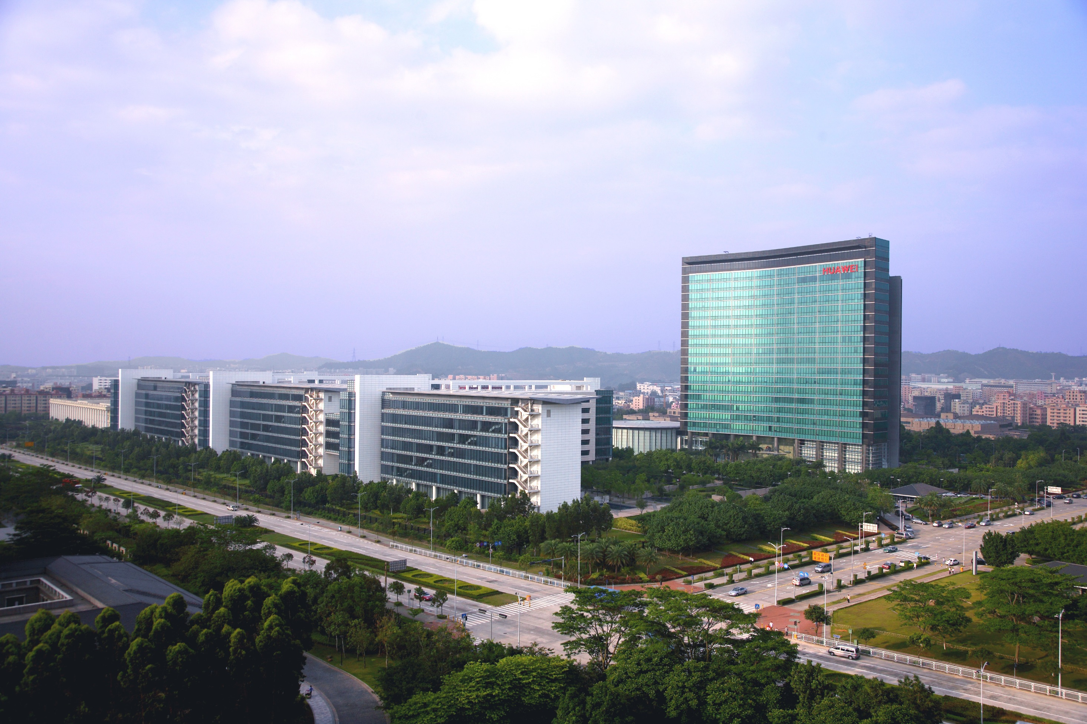
Huawei at a glance
72
Ranking in
the Fortune
Global 500
65%
Business
Out of China
~180.000
Employees
A Global
Leader of ICT
Solutions
170+
Countries
80.000
R&D employees
15%
Invested in R&D
45%
36
Joint
innovation
centers
18
R&D centers
Notes:
Key Messages:
Private company
R&D is de toekomst
15% terug in het investeren
2-5 terug investeren
Huawei is a global leader of ICT solutions. Continuously innovating based on customer needs, we are committed to enhancing customer experiences and creating maximum value for telecom carriers, enterprises, and consumers. Our telecom network equipment, IT products and solutions, and smart devices are used in 170 countries and regions. Huawei ranked 228th on the Global Fortune 500 in 2015 based on its 2014 revenue.
We invest over 10% of our annual sales revenue into R&D and more than 45% of our 170,000 employees engage in R&D. We have built 16 R&D centers worldwide and 31 joint innovation centers with customers.

Slide 3











Leading ICT Products, Solutions, and Services
Bring digital to every person, home and organization for a fully connected, intelligent world.
Hundreds of millions of consumers
Global carriers
Global enterprises, industries
Global cloud users
A brand loved by global consumers
Best strategic partner for carriers
Enabler and preferred partner for digital transformation
An open, reliable cloud platform
70%+ of revenues
from global top 50 carriers
Serving global industries/ large enterprises
Fast growth, reliable and secure services for customers
Top 2 in smartphone market share
94 cloud services in 13 categories
50+ solutions
15.8%
27%
Global
Q2, 2018
China
Q2, 2018

Slide 4
Huawei ICT Academy
Fostering a sound talent Ecosystem
Enabling digital transformation for enterprises

Slide 5




Fostering a Robust Talent Ecosystem to Develop Professionals for Enterprises
Delivering 500,000+ ICT professionals
By 2020
Three Driving Factors
Abundant ICT Talent
Customers
Business
transformation
Huawei
Certification
AI
Public safety
ACAD
Channel partners
Huawei Talent
Alliance Job Centre
Big Data
e-Learning
Finance
Online Learning
anytime, anywhere
ICT
convergence
Cloud Computing
Students
Talent development channel
Rail
ICT Academy
400+
HALP
100+
IoT
Talent
standardization
Customer training
1,000+ courses
General public
Energy
Network
A shortage of 2 million professionals for ICT-related jobs over the next 10 years --- World Bank
Notes:
Give back to society
Close the ICT Gap – Shortage
Multi engineer
By engaging academia, train the teachers, intern train the students to get more skills and more change to get a job.
HALP and customer training = commercial. ICT = CSR

Slide 6









Collaborating Huawei ICT Academy & continuously training High-Quality ICT Talent
400+ Huawei ICT Academies
12,000+ students trained annually
Enterprise-academic
cooperation
Huawei job fair
Academy
Huawei industry
chain
Cloud computing, IoT, Big Data…
600+ instructors
10,000+ ICT professionals in-demand
Exploring innovative talent development models with 58+ top universities worldwide
Notes:
- More detailed picture of previous slide.
- Academy that receive government funding, hand shake is the collab between the 2. We train their teachers, materials, simulations tools, up to 90% on lab equipment.
- HCNA – HCNP – HNCE for every single course. 7 courses in English.

Slide 7

Expanding New ICT Technologies Together with Global Training Partners
100+ HALPs
600+ Trainers
100,000+ Trainees
UK
Russia
Canada
Germany
Poland
Tunisia
UAE
Pakistan
China
Egypt
Mexico
India
Thailand
Colombia
Nigeria
Sudan
Venezuela
Kenya
Malaysia
Huawei Authorized Learning Partner (HALP)
Brazil
Indonesia
3 HALPs offer global delivery capabilities
Australia
South Africa
40+ HALPs provide HCIE training capabilities
65% of HALPs offer training capabilities in IT and cloud fields

Slide 8


Building a New ICT Talent System and Setting Benchmarks for Future Talent
ICT Vertical
Certification
ICT Developer Certification
ICT Infrastructure
Certification
Public Safety
Cloud-based
Cloud service
Expert
Professional
Associate
Finance
  Big Data
  Cloud Computing
  Cloud Service
IoT
  AI
  Storage
  IOT
Big Data
Network-based
  Routing &
  Switching
  Security
  WLAN
Cloud computing
  LTE
  Enterprise Communication
  Transmission
  Access
  Energy Infrastructure
  SDN
  DC Infrastructure
All ICT technical fields
Innovative content
First release globally
82 certification exams and 22 technical fields, providing clear career development paths for ICT practitioners
Notes:
ICT infrastructure:
- In yellow is available
AI not available yet for certification
IOT next year
ICT Developer: If they achieve each one of these it will built up to a developer certification, all 4 of them.
ICT Vertical: not available for academy. Just to show there is another certification possible, they are professional ones.

Slide 9

Success Case: Huawei ICT Academy and University of Alicante
With the development of ICT technologies, University of Alicante：
Needs to upgrade its disciplines
Improve teaching competitiveness
Huawei provides teaching resources：lab equipment, software, and authorized courses
Trained 94 students, 17 passed HCNA certification
Participated in Huawei ICT Competition，won the second prize in the Global Final

Slide 10

Success Case: Huawei ICT Academy and Peking University
Teams up with Peking University, to work on emerging engineering education
Supporting the development of emerging engineering education in the field of software engineering
Provided DevCloud resources for 20,000+ users
Conducted 20+ innovative course reform projects
Jointly released the China ICT Industry Talent Demand Whitepaper

Slide 11
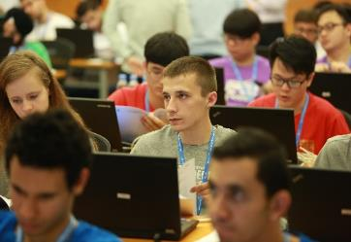
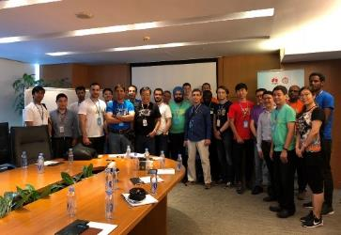

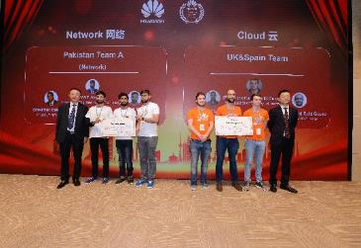
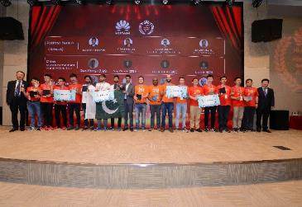
Huawei ICT Skill Competition 2017
Results
  40,000 student contestants from 800+ universities, 29 countries (China, Russia, UK, Australia, Mexico, South Africa, Egypt, India…)
  More than 1 000 students from 10 universities in South Africa, Ghana, Kenya and Nigeria
  Team South Africa won the third prize in Cloud Track
  Team Ghana win the outstanding performance prize in Network Track

